Slide 1
Plan of Action for Vaccine Hesitancy in the US
Can we find where to focus and how to help with vaccine hesitancy for the COVID-19 pandemic?

Slide 2
Overview

Slide 3
Overview
With the COVID-19 pandemic and vaccines being rolled out, people are becoming more safe, but there is a problem with people being hesitant about getting the vaccine.
If we can identify both the counties with problems with being hesitant and which are most likely to change their mind, we can see who to focus our efforts on.
Factors of hesitancy I looked at were demographics of the county, Social Vulnerability Index, CVAC level of concern, population of the county and 2020 voter data.
By using a linear model, we can determine the predicted level of the hesitancy of the county and compare it to the actual hesitancy, and then find the biggest underperformers.

Slide 4
Defining the Problem

Slide 5
COVID-19
Since March of 2020, the US has been hit hard with the COVID pandemic and suffered over 620,000 deaths as well as over 34 million cases of COVID.
COVID-19 has also shut down many places and most states have put restrictions in place to keep their citizens safe, although each state and county has handled it all differently.
With the virus being both highly infectious and deadly, it is important to tackle the problem and do our best to prevent any further problems.
By promoting people to get vaccines, we can help save people’s lives, open up the country and protect ourselves and others from future variants of the disease.

Slide 6
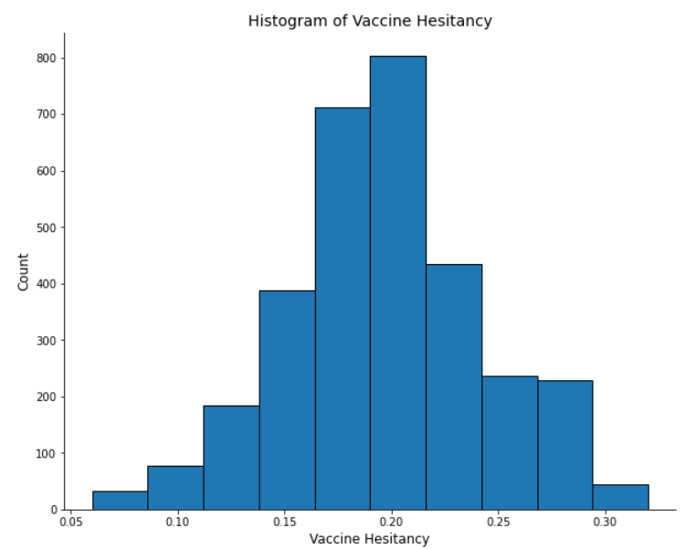
The Vaccine
The US has three major vaccines that were rolled out in waves, Moderna, Pfizer and Johnson & Johnson.
Despite very few problems with the vaccines and efficacy levels that help protect both the recipient and the people around them, there is increasing hesitancy about getting the vaccine.
Counties range from 6-30% hesitant about getting the vaccine, and would rather face the deadly disease head on.
If we can change people’s minds, we make both them and the people around them safer.

Slide 7
Data Understanding

Slide 8

Our Variables
All data about the vaccine and hesitancy were taken from data.gov. This includes demographics about the counties, estimations of hesitancy, Social Vulnerability Index and CVAC levels of concern and FIPS codes for the county
This was combined with voter data from the most recent election, which includes counts of voters for both the democratic and republican candidates in that county, as well as the total number of voters in that county.

Slide 9
Our Variables
Social Vulnerability Index (SVI)
This is a measure of negative effects on communities caused by external stresses on human health.
Stresses include natural and human-made disasters, and disease outbreaks.
SVI ranges from 0-1, the lower the better.
CVAC Level of Concern
This is how difficult it is to roll the vaccine out. Reasons may include:
Historic Undervaccination
Sociodemographic Barriers
Lack of Resources
Healthcare Accessibility Barriers
CVAC ranges from 0-1, the lower the better

Slide 10
Data Preparation

Slide 11
Filling Missing Values
There wasn’t a ton that needed to be done with the data from the dataset.
One thing that needed to be done was filling some missing values, 316 missing counties values for percent of adults fully vaccinated and 1 missing value for Social Vulnerability Index.
These were filled using the median values from the information we had.
With a now full dataset, we could combine the hesitancy dataframe and the 2020 voter dataframe on each county so we could use the information to model the data and predict the hesitancy to find who is underperforming.

Slide 12
Derived Statistics
After pivoting and combining the voter information, we could find the percentage of voters that voted the two major political party to see if this was an indicator vaccine hesitancy that is observed.
We also could add all the voting information to find the total voting population of the county, which is important for making a plan to get people vaccinated. If the population is too low, it may not be worth pouring resources into.
We also needed to one-hot encode our state category since each state took a different approach for handling COVID-19 and so we needed to see which states led to more hesitancy based on their approach.

Slide 13
Modelling

Slide 14
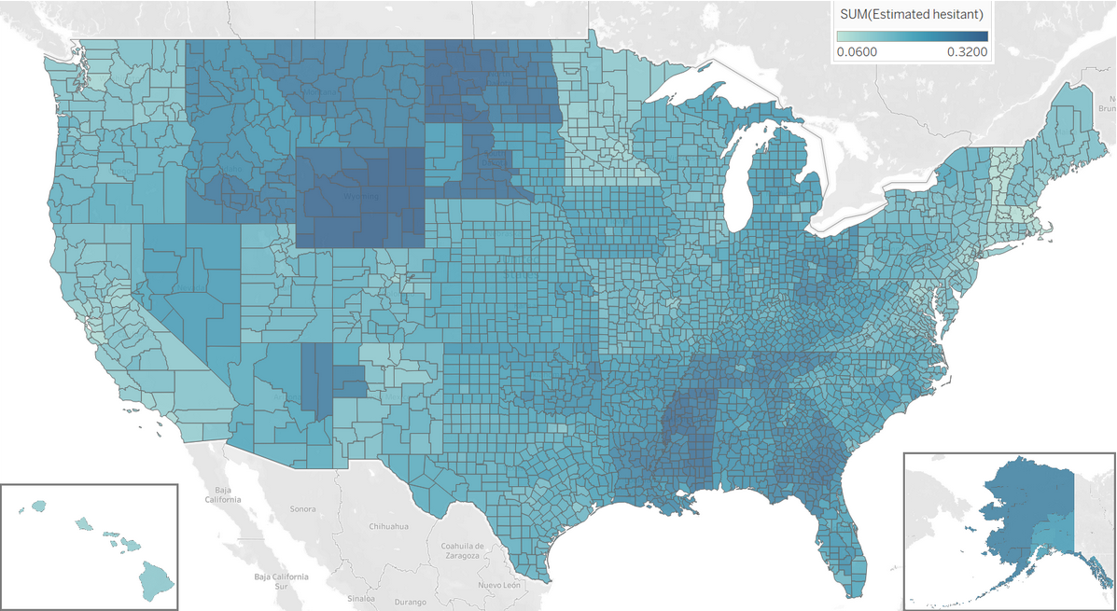
State-Wide Approach
By looking at the hesitancy of each county, there are some pretty noticeable trends to be seen. Some states, such as Wyoming and North Dakota are way more hesitant than any other state and it sticks out.
This isn’t much of a model, but the US as a whole can focus on these states and get them what they need to get vaccinated.

Slide 15
County-Wide Approach
For this, I initially built a model to take in and learn from counties, and then predict the hesitancy of the test set of data after.
This is was not very helpful because we already had all the information we need, and predicting it won’t help us solve the hesitancy problem and locate places that need to be focused on.
By passing in ALL the counties that we had in order to essentially make a linear model, and then find the places that have the highest discrepancy between the actual hesitancy and our predicted hesitancy.
By finding the counties furthest from this line, we can focus on them to get the vaccines.

Slide 16
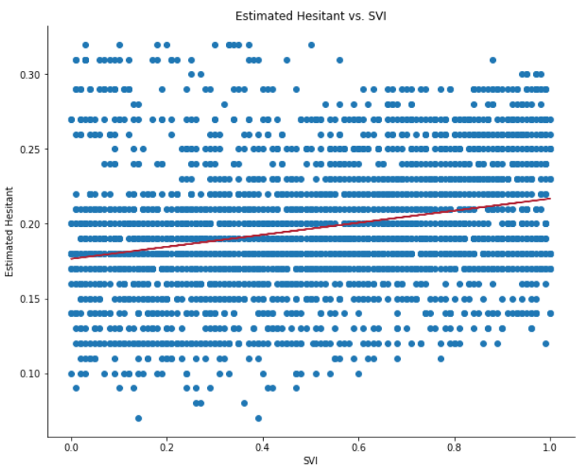
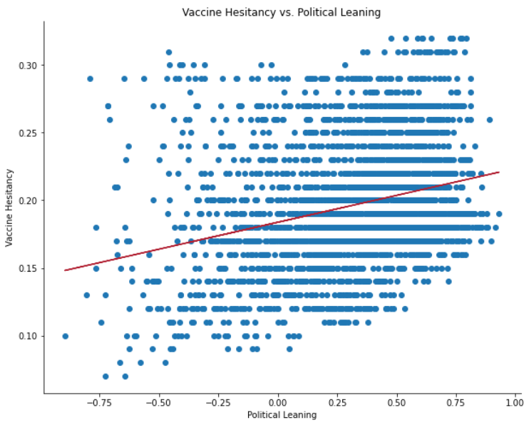
Variables
Counties with higher SVIs had higher hesitancy.
Political leaning (more Democrat on the negative side and more Republican on the positive) showed an increase in hesitancy the further right you went.
Demographics, CVAC, population and state were all also factors in determining the expected hesitancy of a county.

Slide 17
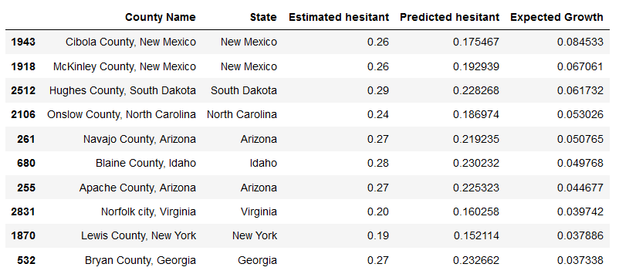
Modelling
By predicting the hesitancy using a linear model, then comparing to the actual hesitancy, we can find the places that are underperforming.
By looking at the difference between predicted and actual hesitancy, then finding the highest values, we would expect to be able to make a difference in these counties.

Slide 18
Conclusion

Slide 19
Summing it Up
Looking at the counties that both are well populated and underperforming in terms of vaccinations, we find the top 10 candidates for counties that may be swayed and convinced to get the vaccine if they have more information.
Of our top 10 counties, there are 4 counties that are all adjacent to each other and connected, which means there is something bigger going on.
By being able to deploy help in this area, you can get 4 of the biggest underperformers all in one area.

Slide 20
Ways to Help
In these areas, we want to find ways to get people vaccinated and alleviate any worries they may have that are making them hesitant.
Information campaigns to help direct people to trusted sources and information about the vaccine.
A website that is the landing page for the campaigns that includes all questions and answer that they may have, and possibly a hotline to call and talk to a medical expert to help resolve any issues that people have.
An incentive program, whether it is a lottery like many states have done, or working with local companies to drive business and convince people to join.
In the end, any person getting vaccinated helps the person, the people around them, the county and the country.

